Slide 1


To Predict Burned Area in Forest
SUBMITTED BY:-
PUSHKAR SHARMA
MTECH DATA SCIENCE
SUBMITTED TO:-
Dr. Rhythm Grover

Slide 2
Statement of the research question and the objective of regression modelling
We are trying to check whether there is a linear relationship between the metrological factors and the forest area burned.
DATA DESCRIPTION
Number of Instances: 517
Number of Attributes: 13
Output variable: 1

Slide 3
Attribute Description
1. X - x-axis spatial coordinate within the Montesinho park map: 1 to 9
2. Y - y-axis spatial coordinate within the Montesinho park map: 2 to 9
3. month - month of the year: ‘Jan’ to ‘Dec’
4. day - day of the week: ‘Mon’ to ‘Sun’
5. FFMC - FFMC index from the FWI (FIRE WEATHER INDEX) system: 18.7 to 96.20 (Fine Fuel Moisture Code) :- FFMC denotes the moisture content surface litter and influences ignition and fire spread.
6. DMC - DMC index from the FWI system: 1.1 to 291.3
(Duff Moisture Code):- Represents the moisture content of shallow and deep organic layers.
7. DC - DC index from the FWI system: 7.9 to 860.6
8. ISI - ISI index from the FWI system: 0.0 to 56.10(Initial Spread Index):-The ISI is a score that correlates with fire velocity spread.
9. temp - temperature in Celsius degrees: 2.2 to 33.30
10. RH - relative humidity in %: 15.0 to 100
11. wind - wind speed in km/h: 0.40 to 9.40
12. rain - outside rain in mm/m2 : 0.0 to 6.4
13. area - the burned area of the forest (in ha): 0.00 to 1090.84

Slide 4
EXPLORATORY DATA ANALYSIS

Slide 5
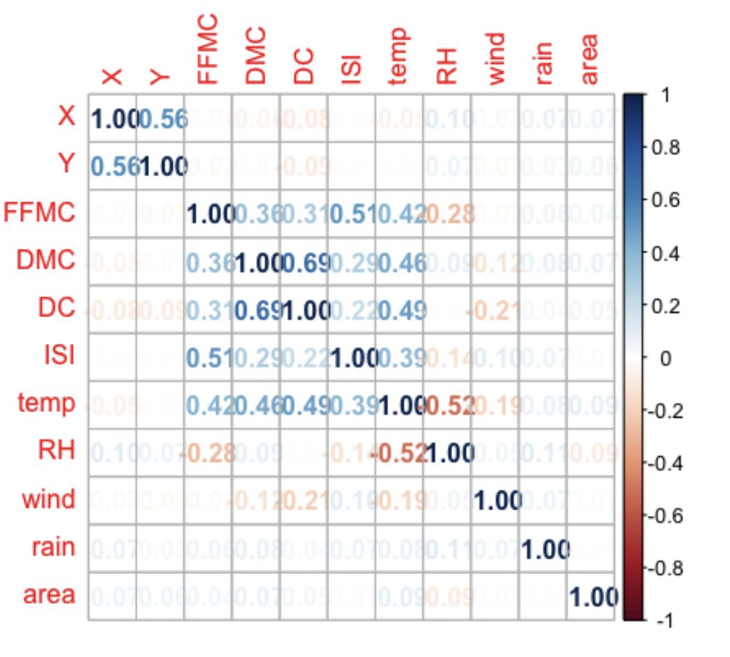
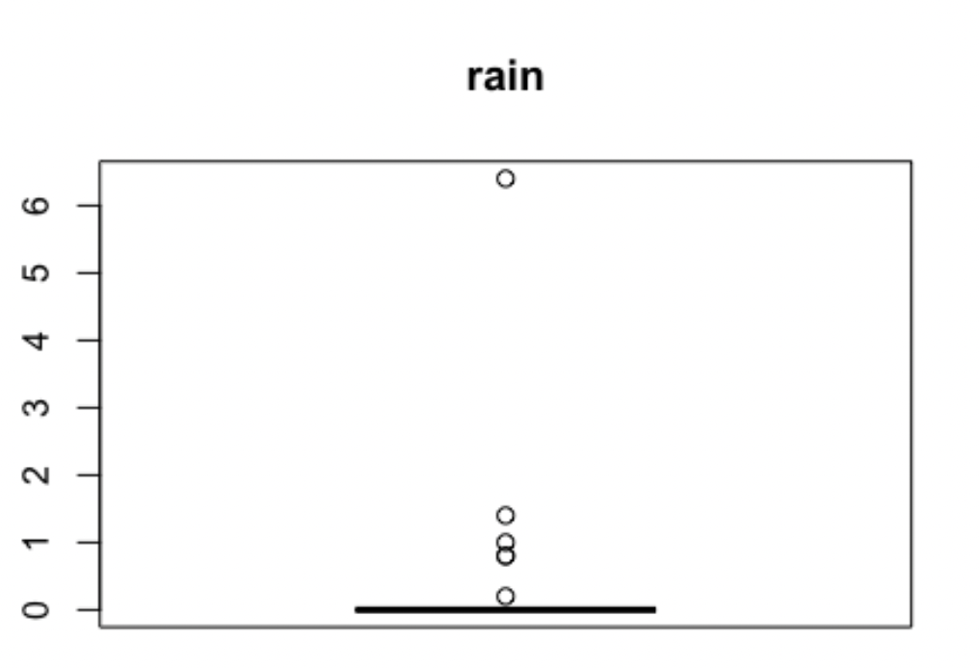
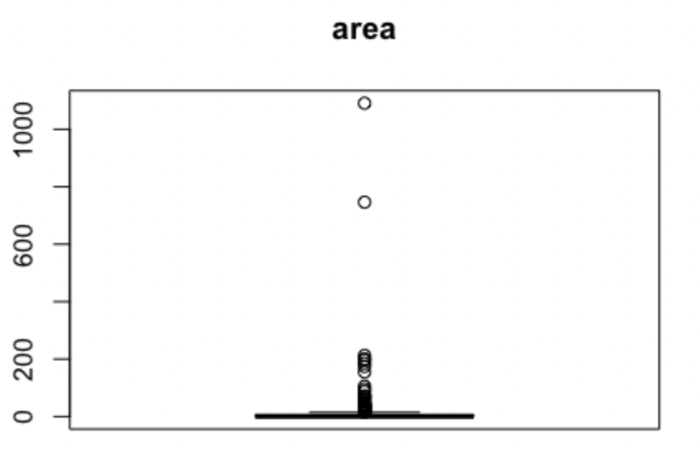
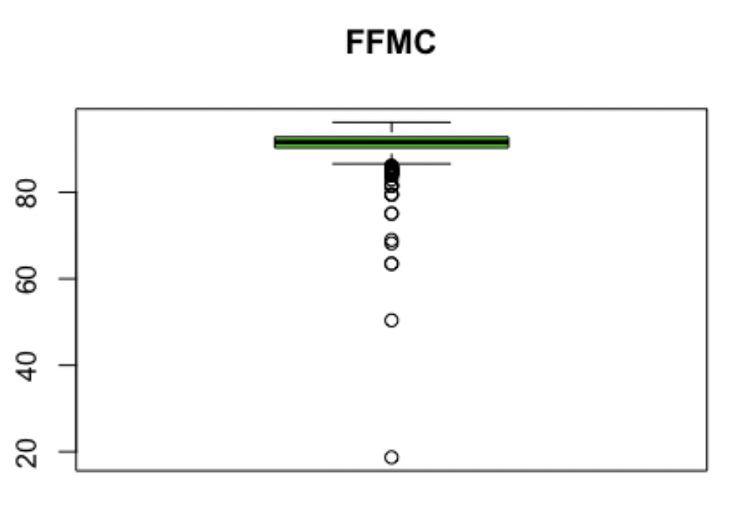
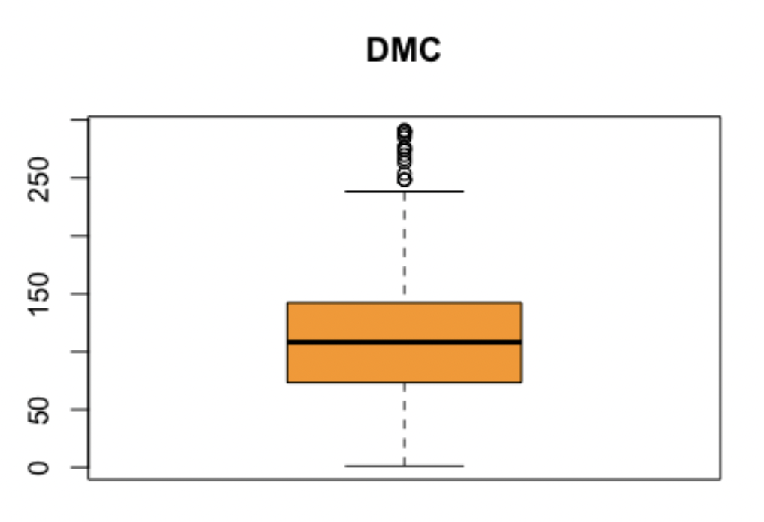
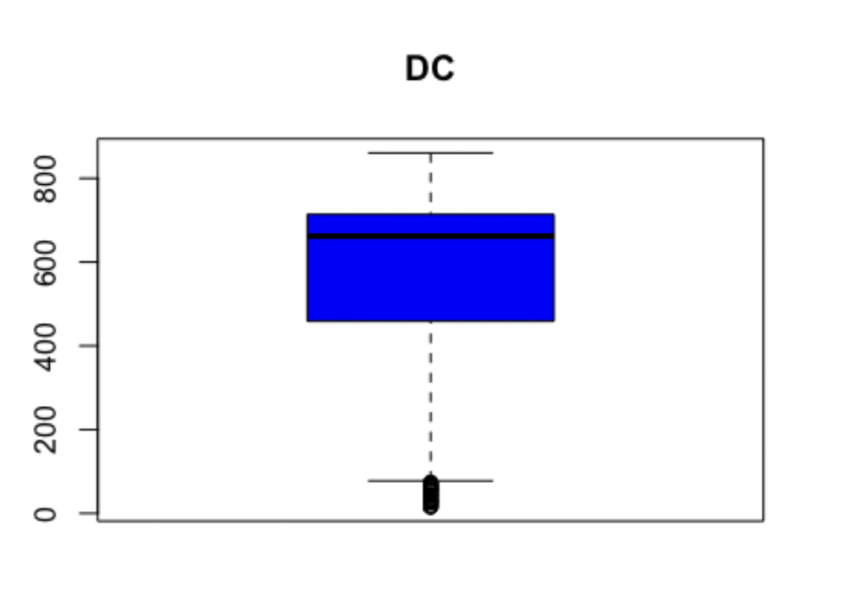
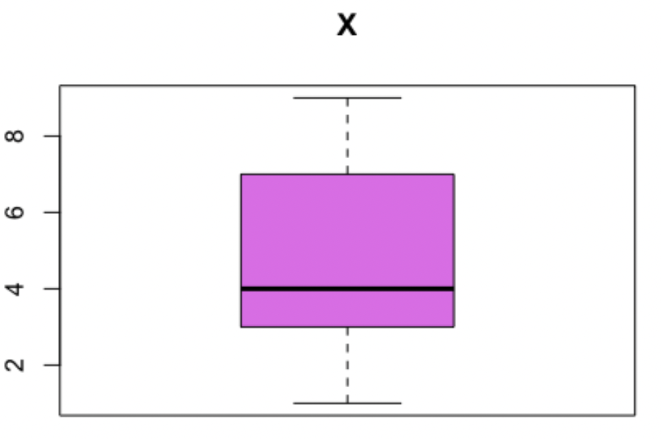
Evident positive correlation between DC & DMC,ISI & FFMC , X &Y , temp & DC.
negative correlation between RH & temp.
positive DC & DMC - this as per definition makes sense
positive temp & DMC -
This somewhat does not makes much sense as moisture should decrease with
temp
negative RH & temp - This is also natural as temp increases humidity decreases.
Asymmetry also observed in variables like X,DC,FFMC from box plot we can easily able to see the outliers and it is clearly seen that the rain and area has high variability and very large outliers.

Slide 6
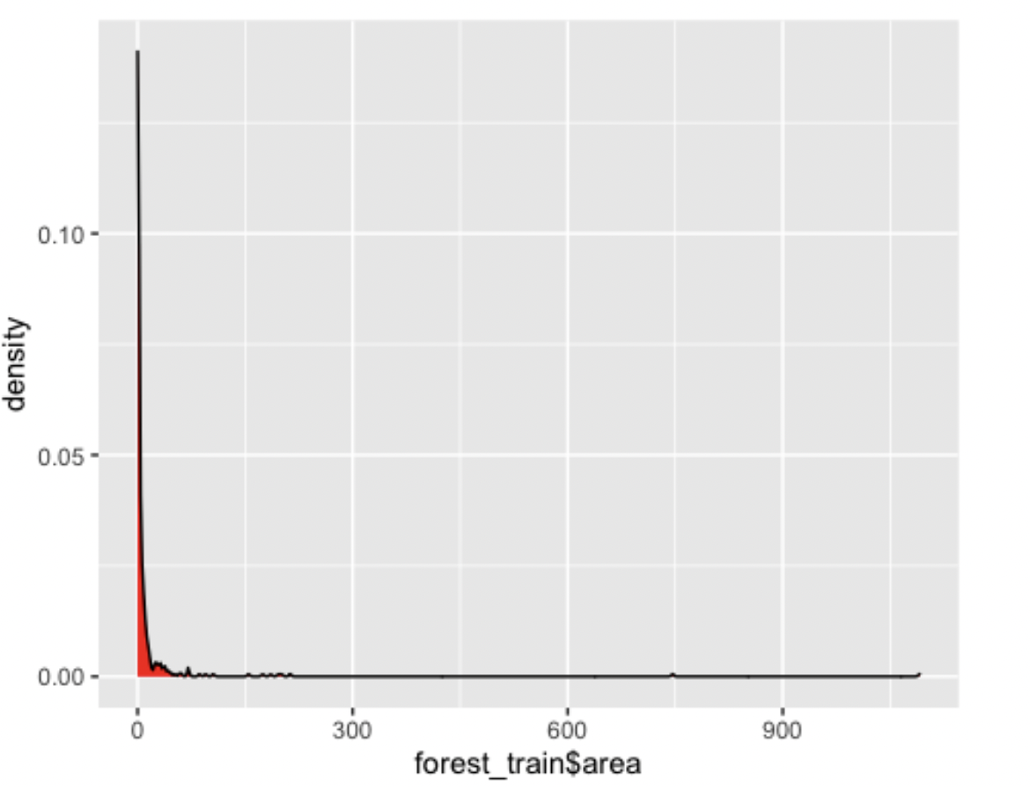
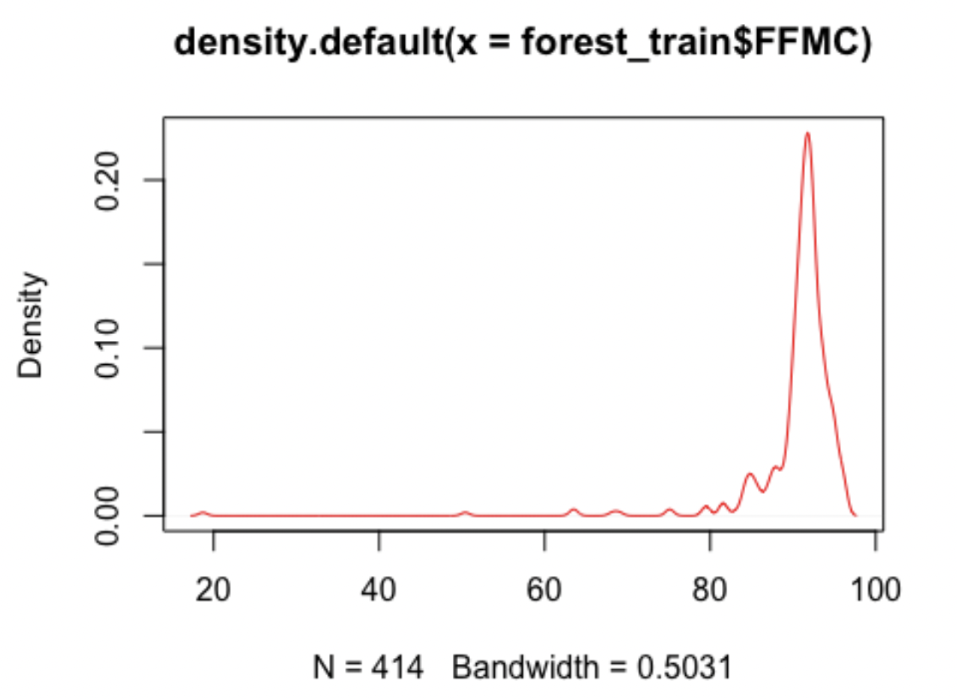
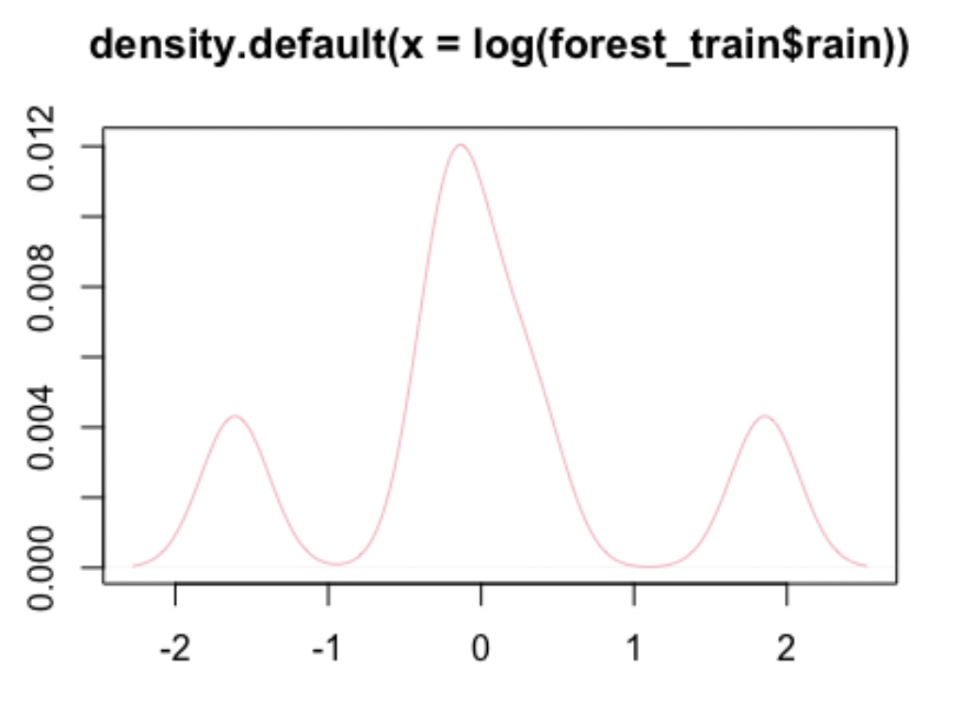
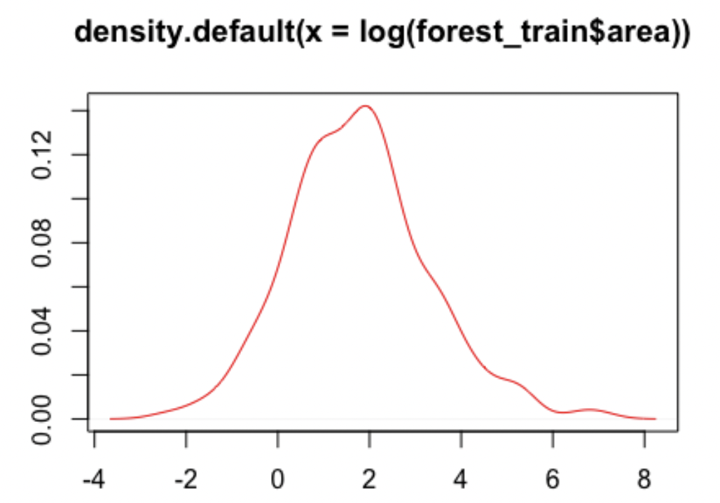
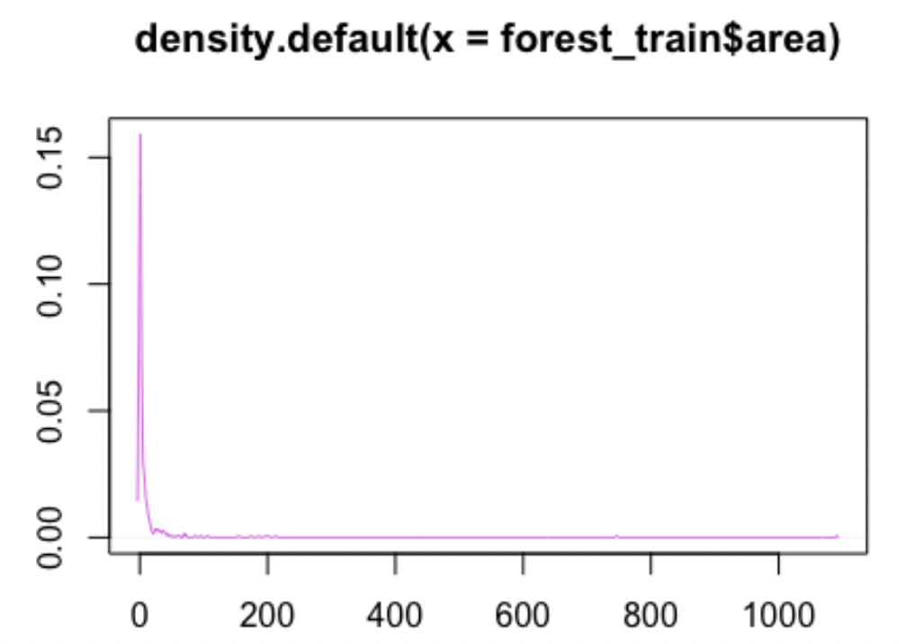
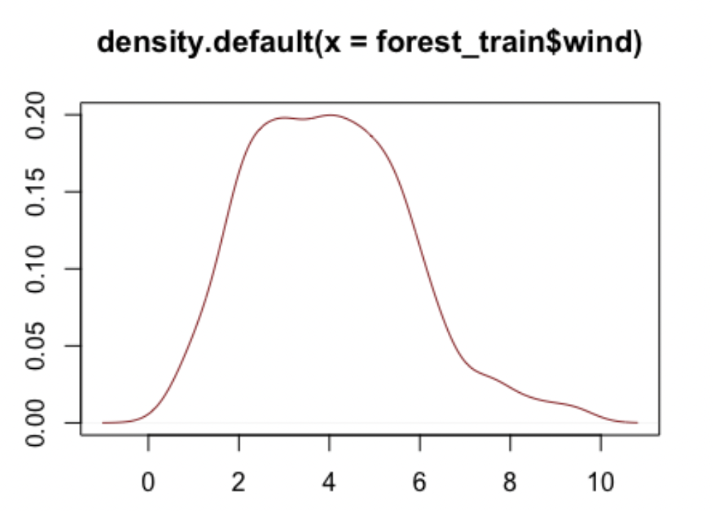
Density plot reflect the log transformation of rain and area, the response variable as it is concentrated near zero

Slide 7
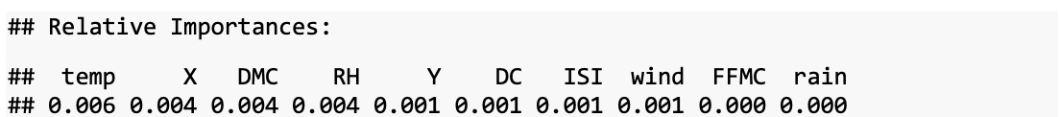
Feature Selection
We can see that the impact of features on a model is very less so without any transformation if we model using linear regression the result will be quite poor.

Slide 8
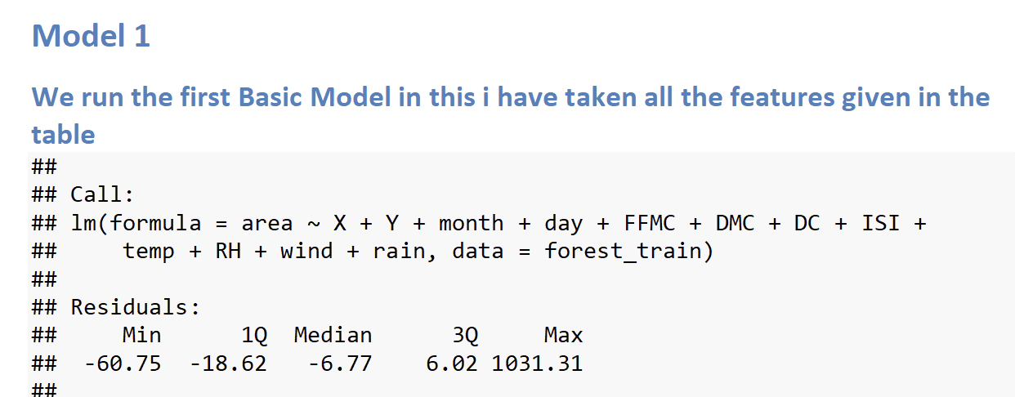
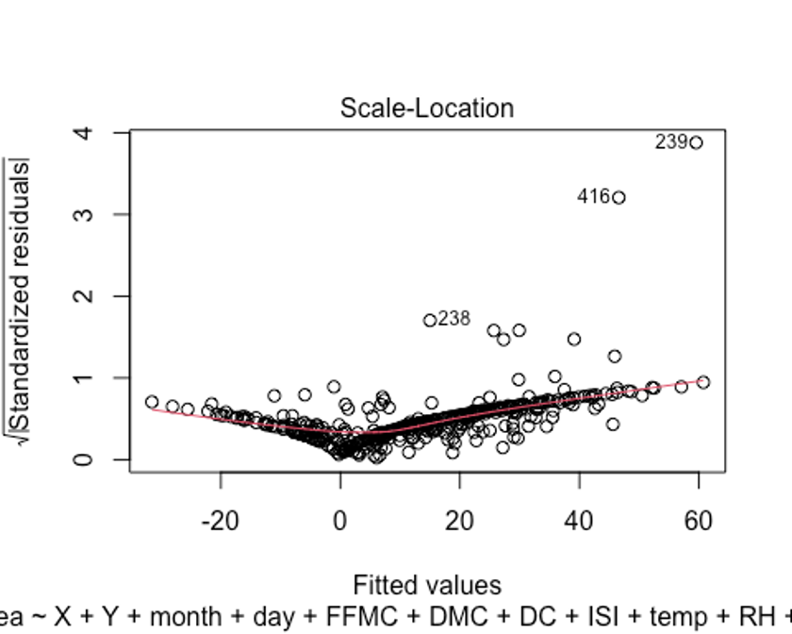
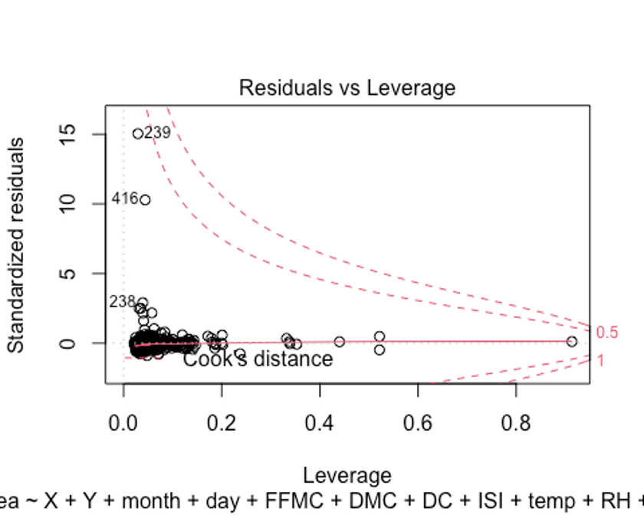
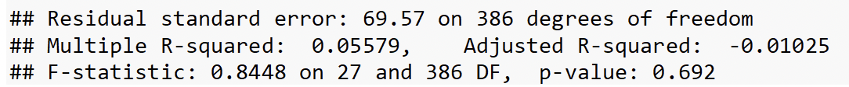
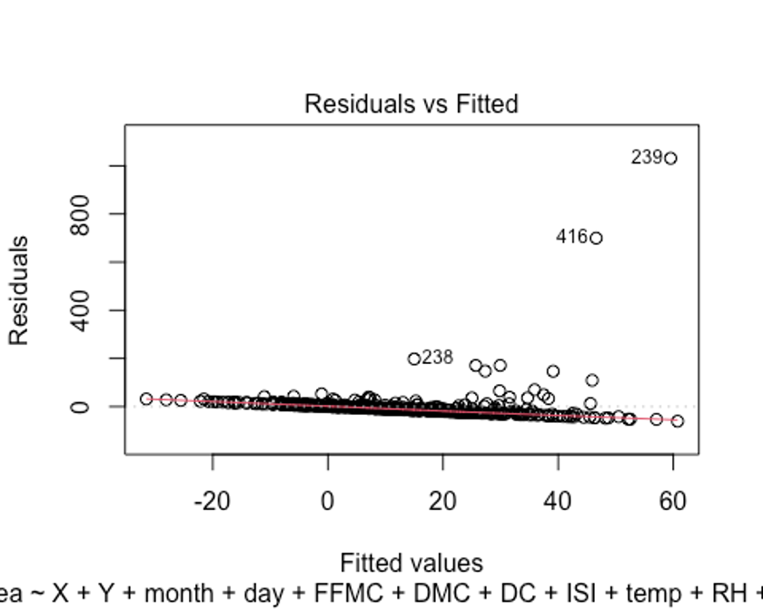
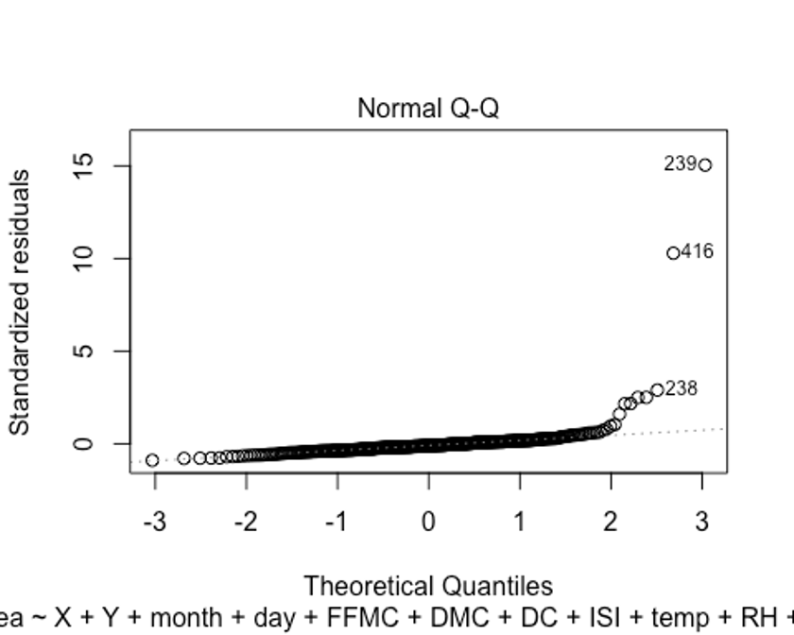
BASIC MODEL
There is negative linear relation between Residuals and Fitted values QQ plot of residuals is also not linear. This indicates there can be Collinearity problems. Residual vs Leverage plot we observed that few points have more impact than other points snd there may be some chance that they will be outliers.

Slide 9
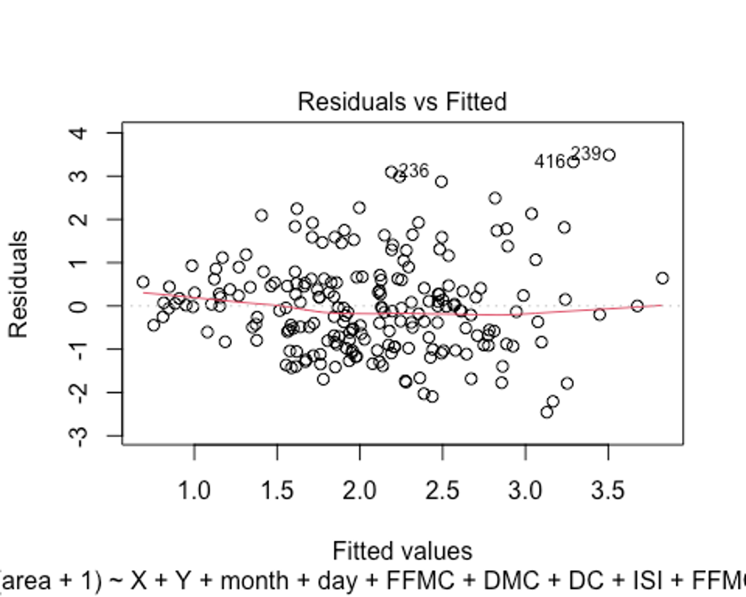
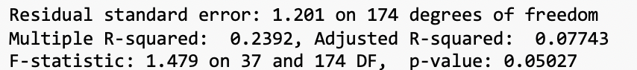
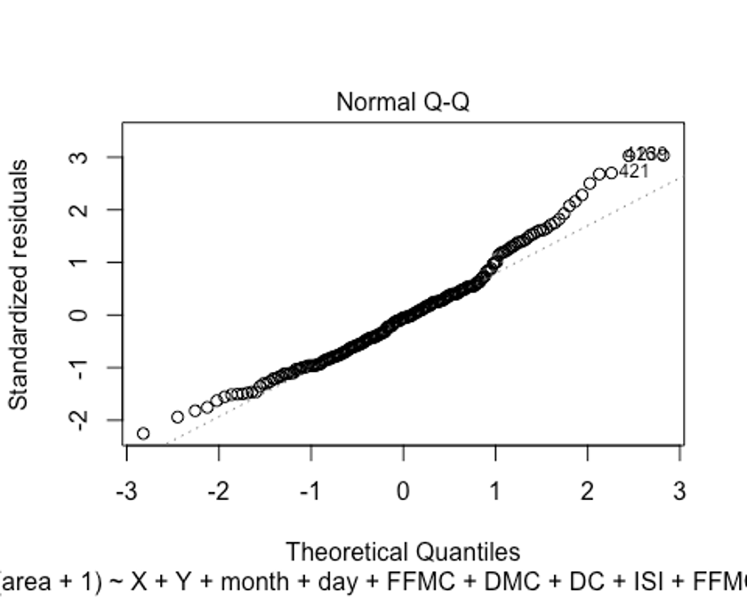
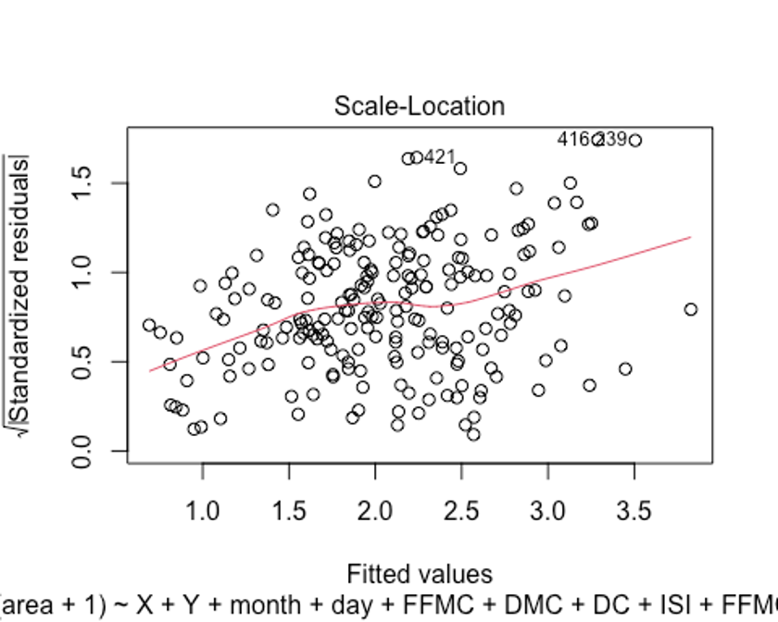
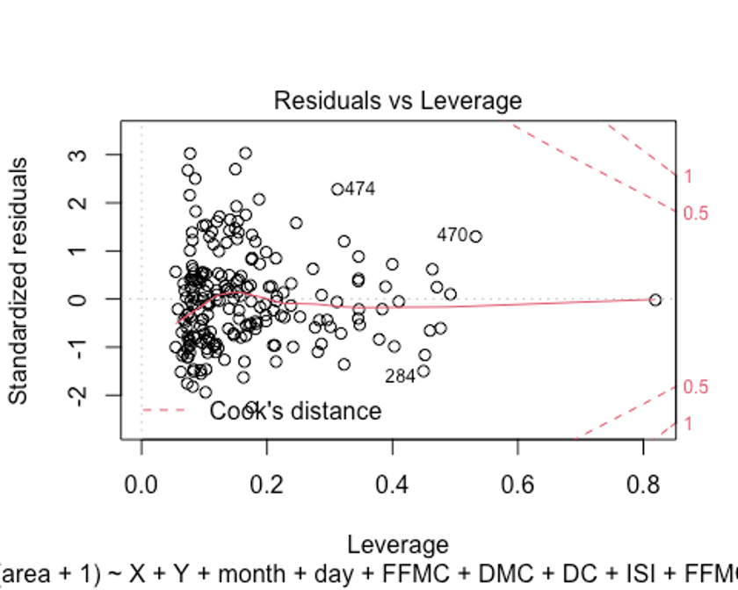
FINAL MODEL
The model is improved in terms of R Square and the residuals are also randomly distributed. Also the QQ plot become linear more compared to the Basic MODEL

Slide 10
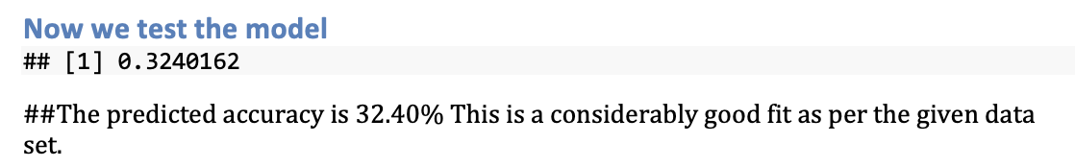
RESULT OF TEST DATA
Interpretations and interesting findings
1. In this we do log transform of some features as shown in above models and also there are many outliers so we remove them and when i am making the model without any transformation then the result which is coming is very poor i.e r square value is very less.
2. One more interpretation or finding is that, data which i initially assumed that it will best fit the regression line , this hypothesis or assumption is proved to be wrong because r2 square by all transformations and complex part increase to .32 only.

